Slide 1
Fairness-Aware Credit Scoring
A Comparative Study and a
Hybrid Model Approach
Presented by –Niyati Malik, Niket Pathak
Responsible Data Science and Algorithmic Fairness (CS 516)
Spring 2025, UIC
Notes:
Hello everyone! I am Niyati and this is Niket, and we will be presenting our project - Fairness aware credit scoring,
We began by evaluating one baseline model — XGBoost — along with 11 fairness-aware models across four credit datasets, using standard fairness and accuracy metrics.
Next, we proposed a novel composite metric that captures both fairness and accuracy, which we used to re-evaluate all the models.
Finally, we conducted an in-depth analysis on the HMDA dataset and developed a hybrid fairness model, aiming to optimize both ethical fairness and predictive performance.

Slide 2
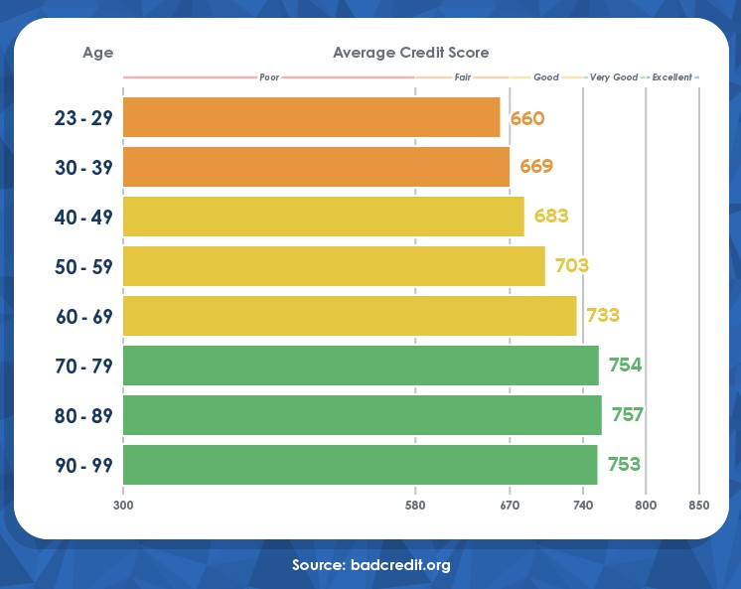
Introduction
Credit scoring models are widely used in lending decisions, impacting individuals' access to financial opportunities.
These models can inadvertently perpetuate existing biases, leading to unfair treatment of certain demographic groups.
Ensuring fairness in credit scoring is crucial for promoting financial inclusion and equity.
Notes:
As we know, these days many financial institutions have started using machine learning models to make credit-related decisions — such as loan approvals. Basically to determine the credit-worthiness of an individual.
But while these models are powerful, they can also unintentionally perpetuate historical biases, which is basically bias that is embedded in the data due to past real world discrimination. This can result in unfair treatment of certain groups, especially based on age, race, or gender. In out project we focus specifically on age.
That’s why fairness in credit scoring is very important — and is essential for financial access to everyone.

Slide 3
Motivation
As financial systems become increasingly automated, algorithmic transparency and fairness are no longer optional — they are essential.
In 2023, the UK’s Financial Conduct Authority warned lenders about potential bias in credit scoring algorithms, especially toward young and minority applicants.
Despite regulations like the Equal Credit Opportunity Act (USA) and similar laws globally, data-driven discrimination still occurs — often undetected.
Most credit datasets reflect historic and structural inequalities, which machine learning models may learn and amplify.
Fairness in credit scoring is not just a technical challenge — it is a matter of equity, accountability, and trust in automated decision-making.
Notes:
Even with regulations like Equal credit opportunity act, discrimination still happens — often against young or minority applicants.

Slide 4
Literature Review
Fairness in ML: Dwork et al. (2012), Barocas et al. (2017) etc defined key fairness notions and highlighted data bias.
Fairness Techniques: AIF360 toolkit (Bellamy et al., 2019) and Exponentiated Gradient (Agarwal et al., 2018) provide popular bias mitigation methods.
Evaluation Challenges: Fairness and accuracy often conflict; models are hard to compare using separate metrics.
Composite Metrics: Metrics like FAUC and FBU try to balance fairness and utility, but lack interpretability or tunability.
Research Gap: No existing metric combines accuracy, SPD, and EOD in a simple, adjustable way
Notes:
Many different research has introduced new fair models, like LFR(Learning fair representations), Adversarial Debiasing etc.
But one major challenge is that fairness and accuracy often conflict, and there’s no easy way to compare models using separate metrics.
Some composite metrics like Fairness-Area-Under-the-Curve, that plots fairness metrics (e.g., SPD, EOD) against accuracy at different thresholds or fairness constraint levels. try to address this, but they often lack transparency or flexibility.

Slide 5
Research Questions
RQ1: How do fairness-aware ML models perform across multiple real-world credit datasets in terms of both accuracy and fairness?
RQ2: Can a composite metric (Responsibility Score) better capture the balance between fairness and accuracy?
RQ3: Which fairness strategy — pre-, in-, or post-processing — offers the most consistent and responsible outcomes?
RQ4: Does a hybrid model combining pre- and in-processing methods improve fairness while balancing accuracy?

Slide 6
Comparative Evaluation of Fairness Aware Models

Slide 7
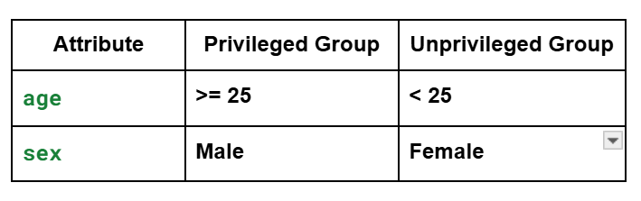
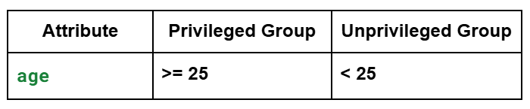
Overview of the Datasets
1. German Credit Dataset
Source: UCI Machine Learning Repository
Focus Area: Germany
Content: Personal and financial details of applicants labeled as good/bad credit risk
2. Give Me Some Credit
Source: Kaggle
Focus Area: United States
Year: ~2000s
Content: Credit history and delinquency prediction for U.S. applicants
Notes:
We used 4 real world datasets

Slide 8
Overview of the Datasets
3. Taiwan Credit Default Dataset
Source: UCI Machine Learning Repository
Focus Area: Taiwan
Year: 2005
Content: Credit card client data including bill payments, limits, and default status
4. Credit Card Approval Dataset
Source: UCI Machine Learning Repository
Focus Area: Australia (assumed)
Content: Loan application data including income, status, and decision outcome

Slide 9
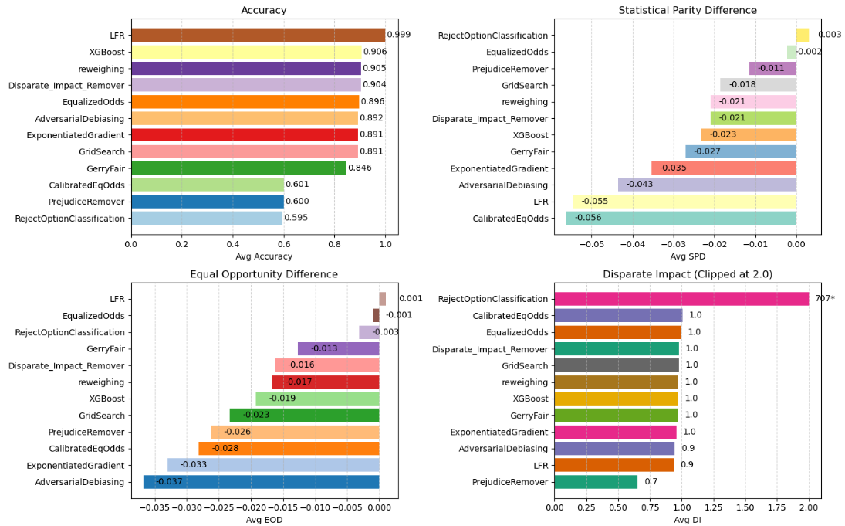
Notes:
So we ran the baseline model - XGBoost, 3 pre processing models - LFR, Disparate Impact Remover and Reweighing, 5 in processing models - Gerryfair, Prejudice Remover, Exponentiated Gradient, Grid Search, Adversarial Debiasing and 3 post processing models - Reject Option Classification, Calibrated Equalized Odds and Equalized Odds over our 4 datasets, and evaluated the values of Accuracy, Disparate Impact, Statistical Parity Difference and Equal Opportunity Difference over all of them. Then we took the mean of the metrics over all the datasets and plotted it.
We can see that LFR, which is a pre processing model, has performed consistently well in terms of all metrics. It has high accuracy, EOD very close to 0, disparate impact close to 1. It does lack a bit in SPD as compared to other models but it has been mostly consistent throughout.
Equalized Odds stood out as the most fairness-consistent model, achieving near-zero SPD and EOD values across datasets with minimal impact on accuracy.
Grid Search and Exponentiated Gradient also performed well, offering a balanced trade-off between accuracy and fairness metrics.
Reject Option Classification although was considerably fair, was the most unstable, with an extremely high Disparate Impact (~707) and low accuracy, making it impractical in real-world scenarios.
Calibrated Equalized Odds and Prejudice Remover had lower accuracy and inconsistent fairness performance.

Slide 10
RQ1
How do fairness-aware ML models perform across multiple real-world credit datasets in terms of both accuracy and fairness?
LFR consistently delivered the highest accuracy (~99.9%) and strong fairness It was the best-performing model overall.
Equalized Odds stood out as the most fairness-consistent model, achieving near-zero SPD and EOD values across datasets with minimal impact on accuracy.
Grid Search and Exponentiated Gradient also performed well, offering a balanced trade-off between accuracy and fairness metrics.
Reject Option Classification although was fair, was the most unstable, with an extremely high Disparate Impact (~707) and low accuracy, making it impractical in real-world scenarios.
Calibrated Equalized Odds and Prejudice Remover had lower accuracy and inconsistent fairness performance, placing them near the bottom in Responsibility Score rankings.

Slide 11
Responsibility Score
A single score that reflects both ethical and predictive performance.
Responsibility Score (RS) =
α × Accuracy – β × |Statistical Parity Diff| – γ × |Equal Opportunity Diff|
Where,:
α, β, γ are weights (we took., α = 1, β = 2,, γ = 2)
Higher RS means better overall model behavior
Models with high RS perform well without being unfair.
Helps identify balanced models, not just accurate or just fair.
Notes:
To better evaluate our models, we created a composite metric called the Responsibility Score, or RS.
It combines accuracy, Statistical Parity Difference, and Equal Opportunity Difference using a weighted formula.
We chose weights α = 1, β = 2, γ = 2 to put more emphasis on fairness, since we're working in a high-stakes domain like credit scoring.
The formula is flexible — people can customize the weights based on their priorities. For example, a bank might prioritize accuracy, while a regulator might care more about fairness.
A higher RS means a model is doing well overall — it’s accurate and fair — making it easier to identify the most responsible models.

Slide 12
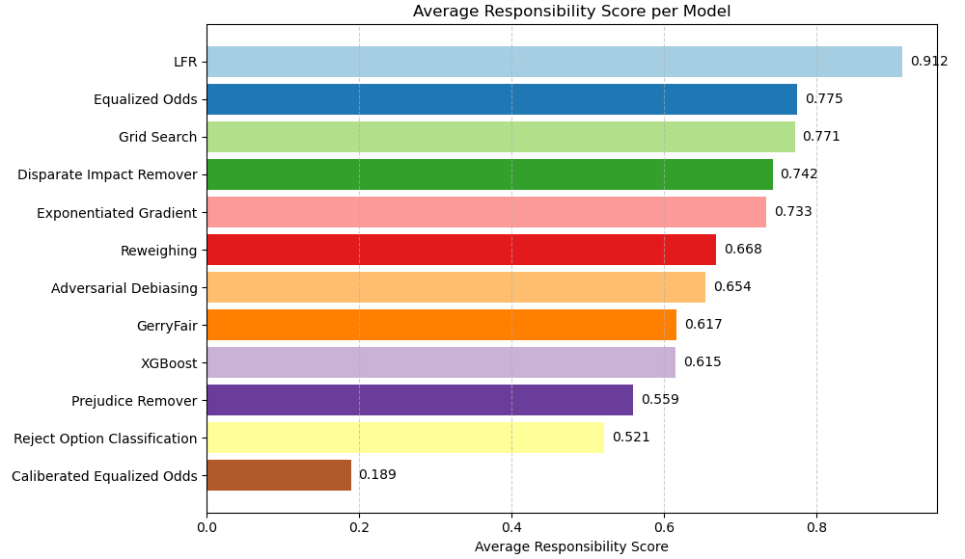
Notes:
As we can see, based on the responsibility score as well, LFR performed the best.

Slide 13
RQ2
Can a composite metric (Responsibility Score) better capture the balance between fairness and accuracy?
Responsibility Score effectively captured the trade-off between fairness and accuracy in a single, interpretable value.
Simplified evaluation, helped identify ethically balanced models, and supported more responsible model selection in high-stakes domains like credit scoring.
LFR achieved the highest RS across datasets, showing near-perfect accuracy and strong fairness — making it the top-performing model overall.
Equalized Odds and Grid Search also ranked high under RS, demonstrating its ability to highlight well-rounded models.
Models with extreme fairness violations or very low accuracy naturally received lower RS, reflecting their practical limitations.

Slide 14
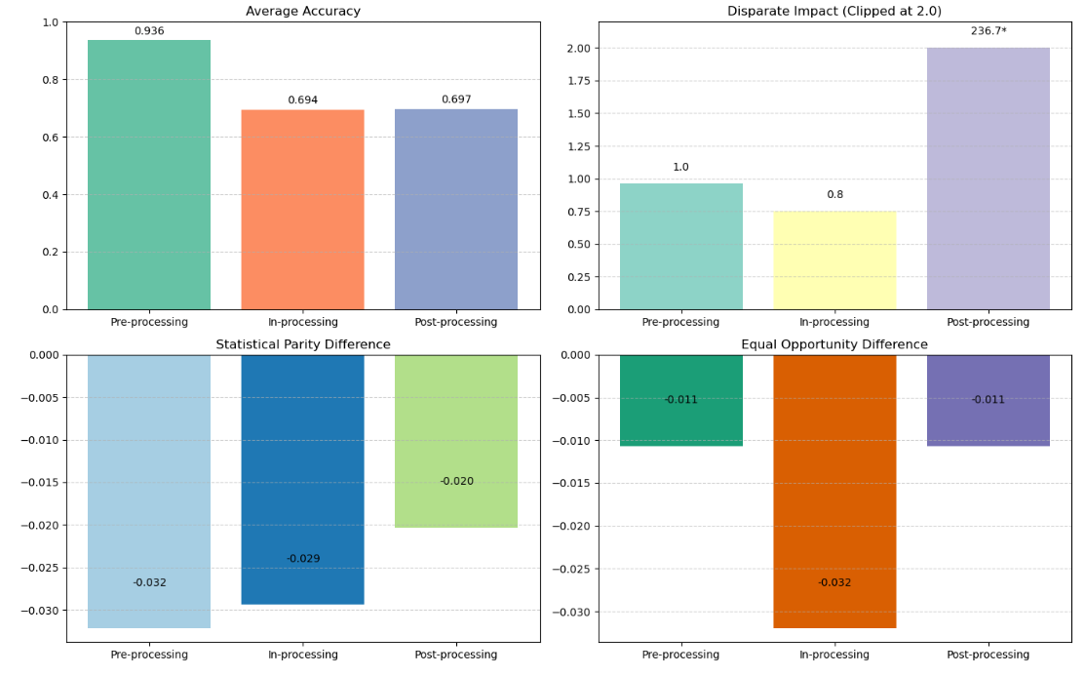
Notes:
Now we took the average of the metrics for all the kinds of fairness models to see what type performs best.
And as we can see , pre processing models have the best accuracy and also perform well when it comes to fairness. Maybe not much for SPD, but good for disparate impact and EOD.

Slide 15
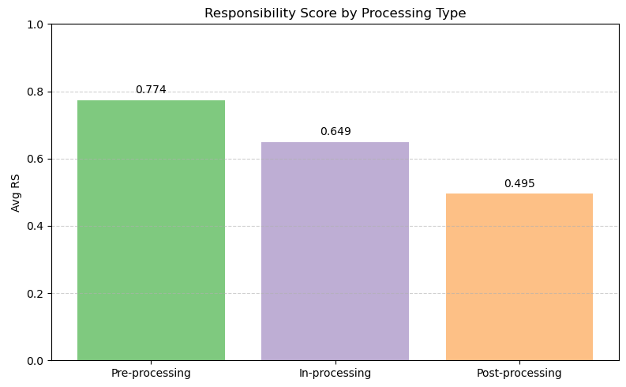
Notes:
Even based on responsibility score, pre processing models - LFR, Reweighing and disparate impact remover, perform the best overall.

Slide 16
RQ3
Which fairness strategy — pre-, in-, or post-processing — offers the most consistent and responsible outcomes?
Pre-processing methods achieved the highest average accuracy and Responsibility Score.
LFR had near-perfect accuracy and the highest RS overall.
In-processing methods (e.g., Exponentiated Gradient) offered moderate fairness improvement, but sometimes reduced accuracy.
Performance was less stable across datasets.
Post-processing methods showed the least consistency:
Reject Option Classification produced extreme values (e.g., DI > 700), skewing the group average.
While Equalized Odds performed well in fairness, others like Calibrated EqOdds had low accuracy.

Slide 17
Fair ML Interventions on HMDA Loan Approvals
Notes:
Hi everyone! This section focuses on ensuring fairness in automated credit decision systems using real-world data. Specifically, we explore a hybrid approach combining two fairness interventions — one that adjusts data, and one that adjusts model training — applied to mortgage approval data from HMDA.

Slide 18
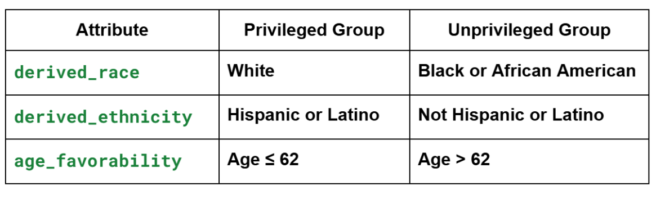
Overview of the HMDA Dataset
Source: Home Mortgage Disclosure Act (HMDA) data
Focus Area: State of Illinois Year: 2018
Content: Mortgage application records with applicant demographics, financial variables, and approval outcomes
Protected Attributes and Group Definitions
Notes:
The dataset comes from the Home Mortgage Disclosure Act for the year 2018, focusing on Illinois. It includes details like applicant demographics, loan amounts, credit scores, and whether the loan was approved. This makes it ideal for fairness analysis because it contains both sensitive attributes and decision outcomes.
We selected three key protected attributes:
Race: White as privileged, Black or African American as unprivileged
Ethnicity: Hispanic or Latino as privileged, others as unprivileged
Age: Age ≤ 62 is considered privileged, above 62 is unprivileged These definitions help us study systemic disparities in approval decisions across groups.

Slide 19
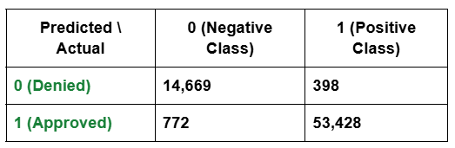
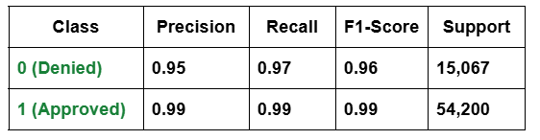
Baseline Model: Random Forest Classifier
Accuracy: 98.31%
Confusion Matrix
Classification Report
Extremely high precision and recall for the approved class (1).
Minor false positives and false negatives — strong model reliability.
Notes:
Our baseline model — a Random Forest — achieved high accuracy: over 98%. It had excellent precision and recall, especially for approved loans. But the key question is: despite great performance, is this model fair?

Slide 20
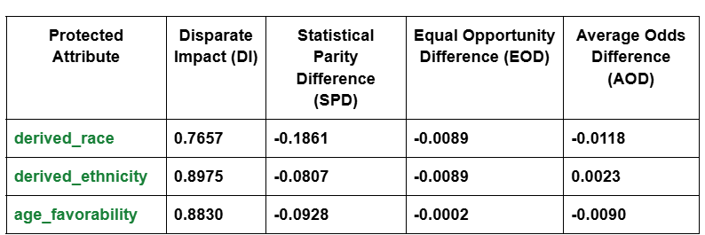
Baseline Fairness Metrics
DI < 0.8 signals potential disparate impact.
SPD < -0.1 indicates meaningful difference in selection rate.
derived_race shows the most significant fairness violation.
Notes:
We evaluated fairness using standard metrics. For race, the Disparate Impact was below 0.8 and SPD was below -0.1, signaling bias. Among all protected groups, race showed the highest disparity, making it our main focus for mitigation.

Slide 21
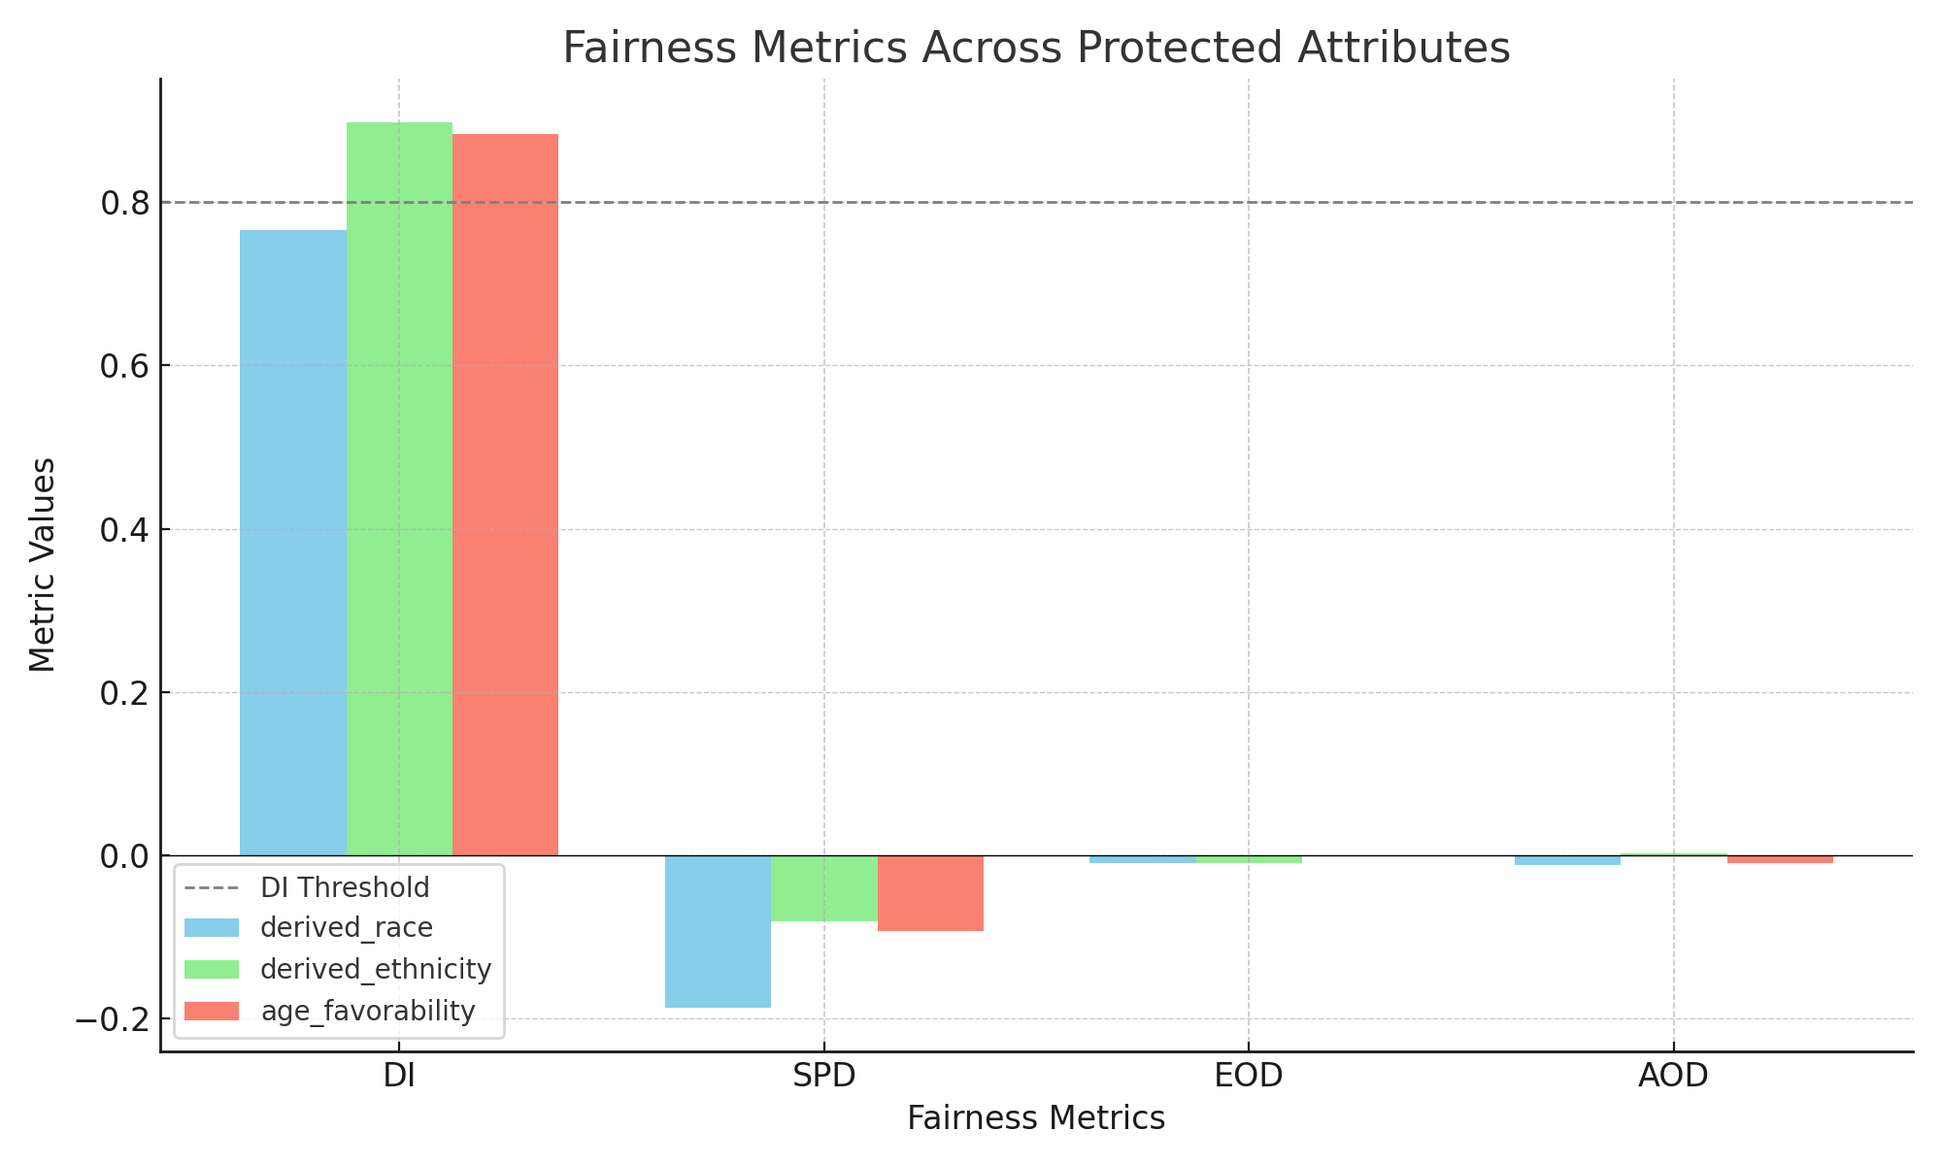
Fairness Metric Comparison
derived_race consistently shows the most severe fairness violations across metrics. Thus is the primary focus for mitigation.
Notes:
This slide visually compares fairness across attributes. As you can see, derived_race consistently violates fairness metrics more than ethnicity or age. This confirms it’s the most affected and in need of corrective intervention

Slide 22
Hybrid Fairness Interventions
Why Hybrid?
DIR addresses systemic bias in the data.
EGR targets residual bias in model predictions.
Like treating both the cause (biased features) and symptom (biased outputs).
Provides robustness: one compensates if the other falls short.
Enables fairness without excessive accuracy loss.
Notes:
We adopted a hybrid fairness pipeline to address both systemic bias in the data and bias introduced during model training.
Disparate Impact Remover (DIR) corrects for biases present in the input features, tackling structural inequalities in the data itself.
Exponentiated Gradient Reduction (EGR) enforces fairness constraints during training, ensuring the model’s decisions are not discriminatory.
This combination allows us to treat both the cause (biased features) and the symptom (biased predictions) — resulting in a more robust and fair model with minimal loss in accuracy.

Slide 23
Hybrid Fairness Mitigation Pipeline
Combination:
Disparate Impact Remover (Pre-processing)
Exponentiated Gradient Reduction (In-processing)
Two Scenarios:
Scenario A: Repair level = 1.0, ε = 0.10
Scenario B: Repair level = 0.7, ε = 0.05
Raw Data
Disparate Impact Remover
Fair Features
Exponentiated Gradient Reduction
Fair & Accurate Model
Notes:
This is the workflow:
Raw data is passed through the Disparate Impact Remover
Fair-transformed features go into the Exponentiated Gradient classifier
We tested two scenarios — a full repair (aggressive fairness) and a partial repair (moderate fairness) — and compared results on both performance and equity.

Slide 24

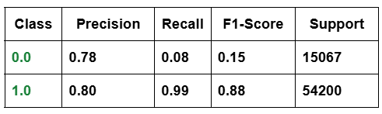
Full Repair: repair_level = 1.0, ε = 0.10
Bias almost fully removed
(DI ≈ 1).
Massive loss in accuracy: mainly because recall for class 0 dropped to just 8%
Model Evaluation Summary
Not practical for real-world deployment because it sacrifices minority prediction quality.
Classification Report
Notes:
In this aggressive setup, we almost eliminated fairness gaps — DI was close to 1.
But accuracy suffered significantly, especially for class 0 (denials), where recall dropped to 8%. This approach is not deployable in practice due to poor predictive performance for negative class.

Slide 25

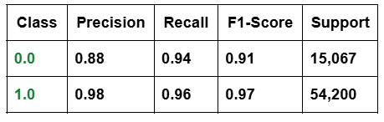
Partial Repair: repair_level = 0.7, ε = 0.05
High fairness achieved while maintaining strong accuracy (~96%)
Minor trade-off between precision and fairness, but much more acceptable
Model Evaluation Summary
Practical for deployment – improves fairness with minimal impact on accuracy and minority prediction quality.
Classification Report
Notes:
This scenario achieved a strong balance. Accuracy remained high (~96%), and fairness metrics improved significantly. This shows that partial repair is a more practical solution for real-world deployment — it reduces bias without heavily sacrificing performance.

Slide 26
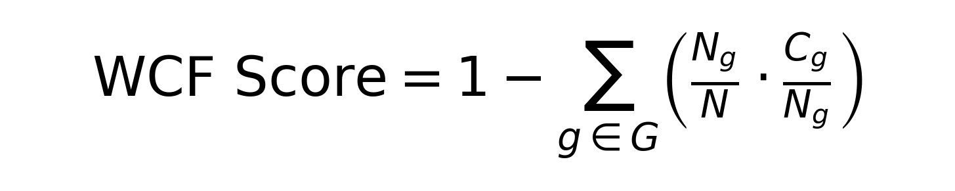
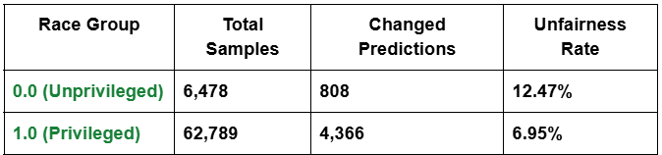
Counterfactual Fairness Evaluation
0 = highly unfair,
1 = perfect counterfactual fairness
Weighted Counterfactual Fairness Score: 0.9249
Overall counterfactual fairness is strong
Unprivileged group still shows higher unfairness
Indicates individuals are generally treated fairly across race after mitigation
Per-Race Unfairness Table
Notes:
Counterfactual analysis checks if changing protected attributes would change predictions. We achieved a high counterfactual fairness score of 0.9249, but disparities remained — the unprivileged group had more prediction flips. Still, this suggests the model treats individuals consistently across demographic changes post-mitigation
G: Set of protected groups (e.g., races) N: Total number of individuals Ng​: Number of individuals in group g Cg​: Number of individuals in group g whose prediction changed under any counterfactual switch
Cg\Ng​​: Unfairness rate within group g
NgN​​: Weight of group gin the total population

Slide 27
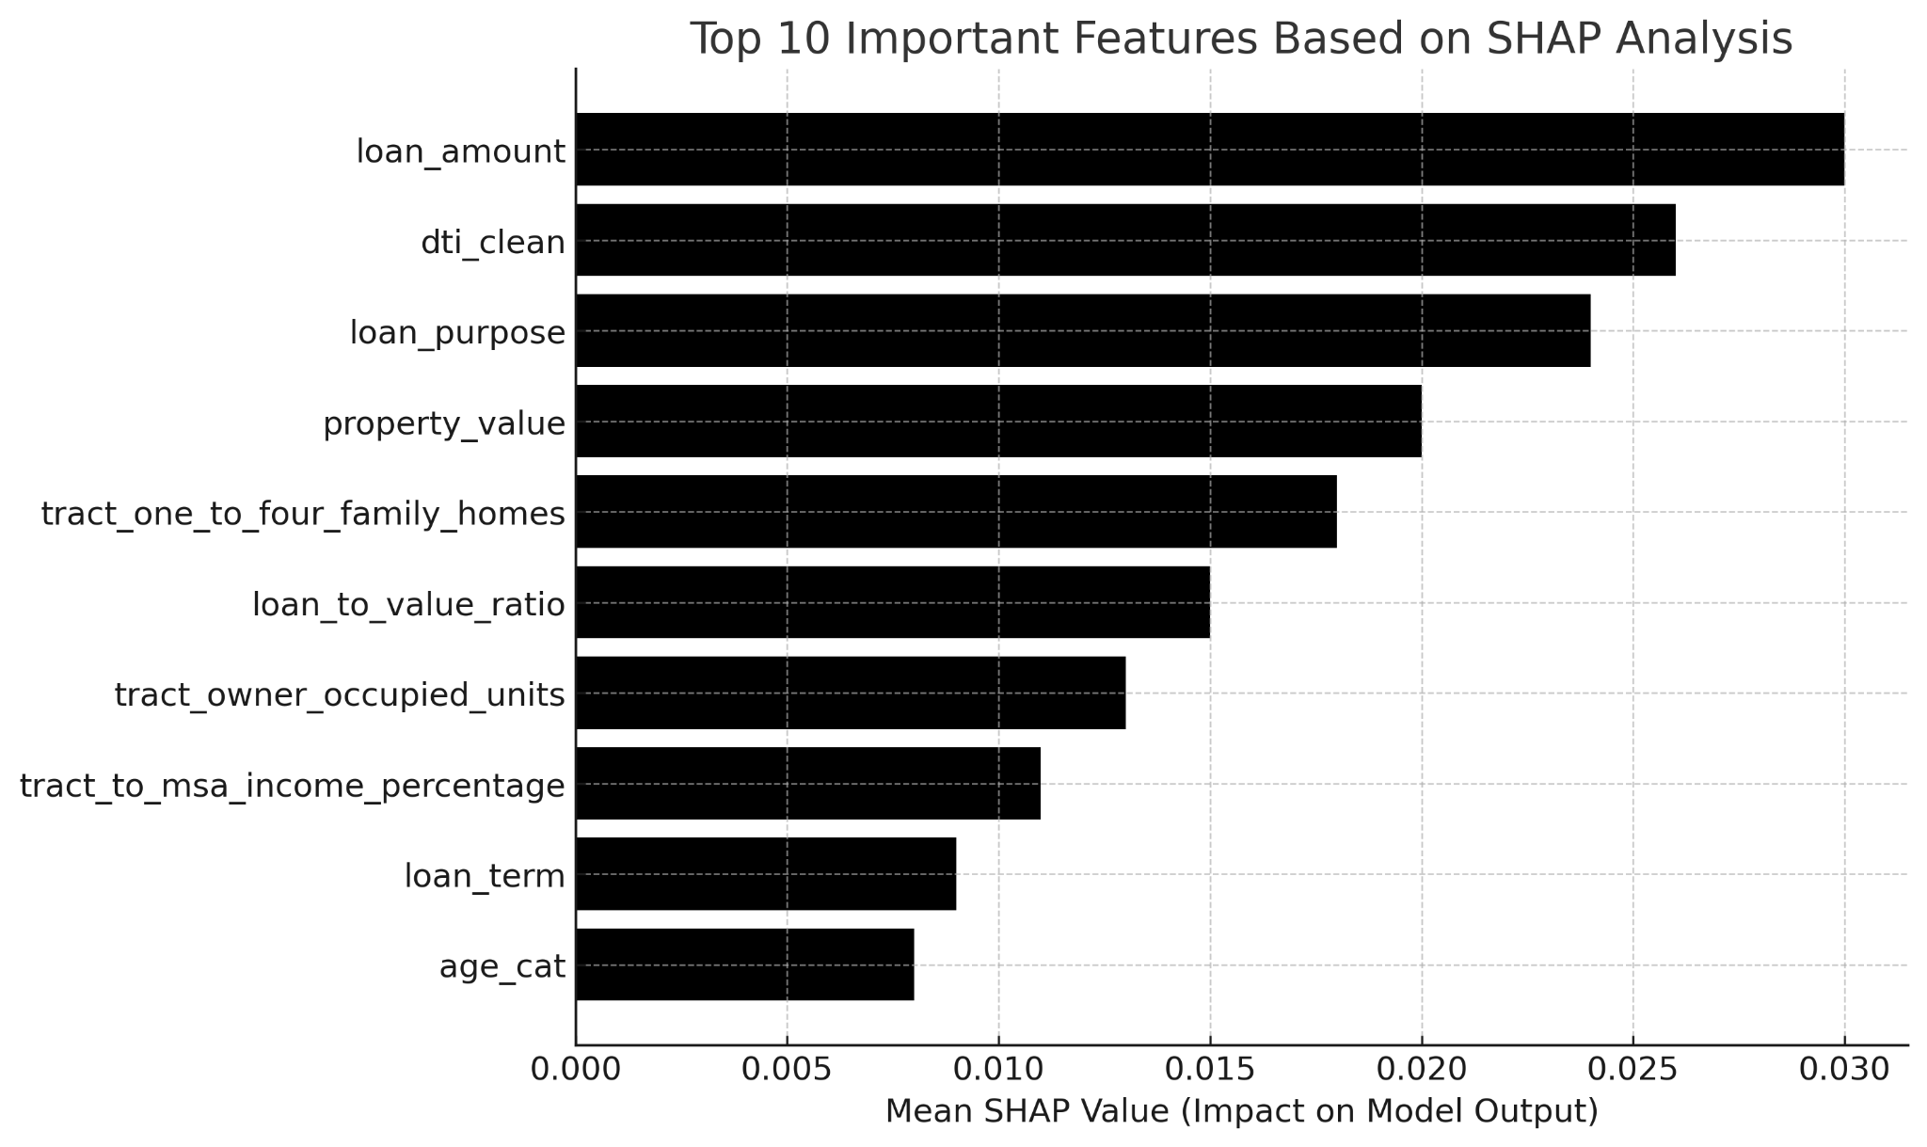
SHAP Analysis (Feature Importance)
loan_amount, dti_clean, loan_purpose, and property_value are the most influential features.
derived_sex and derived_ethnicity have very low SHAP values, indicating minimal direct influence
Tract-level features may indirectly reflect race or income, posing potential fairness concerns.
SHAP shows that model predictions are driven by financial factors, not sensitive attributes
Notes:
SHAP helps us interpret what features the model uses most. Top drivers were financial — loan amount, DTI, loan purpose, property value.
Sensitive attributes like ethnicity and sex had very low influence, which is great.
However, tract-level location features still pose a proxy risk and should be monitored

Slide 28
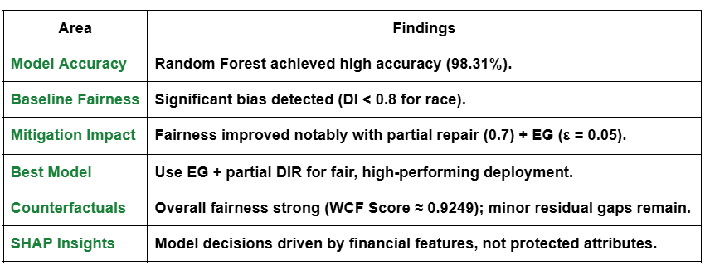
Key Takeaways - Fairness Evaluation
Notes:
In summary: the hybrid model improved fairness significantly. Partial repair with EG achieved a good balance of accuracy and fairness, confirmed by SHAP and counterfactual analysis

Slide 29
RQ4
Does a hybrid model combining pre- and in-processing methods improve fairness while balancing accuracy?
Answer: Yes
Hybrid Approach (Disparate Impact Remover + Exponentiated Gradient) significantly reduced fairness disparities across race, ethnicity, and age.
Partial Repair (0.7) + EG (ε = 0.05): delivered the best trade-off:
High accuracy (~95.9%)
Strong fairness metrics (DI ≈ 0.94, SPD ≈ -0.047)
SHAP & Counterfactual Analysis confirmed that decisions are driven by financial features, not protected attributes, and individual-level fairness is well maintained (WCF Score ≈ 0.92).
Notes:
Yes — our results show that combining pre- and in-processing techniques reduces bias without major performance loss. This approach is practical and effective.

Slide 30
Challenges Faced During the Project
Different fairness metrics (SPD, EOD, DI) sometimes contradicted each other. It was difficult to compare models holistically without a composite score — hence, the need for the Responsibility Score.
The four datasets had different target labels, feature distributions, and protected attributes, requiring careful preprocessing and normalization for consistent analysis.
Balancing Fairness and Accuracy Finding the right repair level and constraints to reduce bias without compromising model performance required careful experimentation.
Ensuring Transparency Maintaining interpretability after applying fairness interventions required additional analysis using SHAP.
Notes:
We faced several challenges — metric conflicts, data inconsistencies across datasets, tuning trade-offs, and ensuring interpretability post-fairness repair. SHAP helped regain transparency.

Slide 31
Conclusion
This project examined fairness-aware machine learning models for credit decision systems using real-world datasets. By comparing models across fairness and accuracy metrics and introducing a unified Responsibility Score, we identified techniques that balance both goals. While some methods showed consistent results, achieving fairness without compromising performance remains a key challenge.
Notes:
Our project confirms that fairness in ML isn’t just possible but measurable. With the right combination of techniques, we can build models that are both accurate and equitable — though careful tuning and interpretability are essential.

Slide 32
THANK YOU!
Notes:
Thank you for your attention. We happy to take any questions or feedback on the approach and findings.
Applying Disparate Impact Remover (gentler repair)
Optimizing: α × Accuracy – β × |SPD| – γ × |EOD| ...
eps=0.01, Accuracy=0.962, SPD=0.071, EOD=0.018, Score=0.912
eps=0.05, Accuracy=0.959, SPD=0.051, EOD=0.012, Score=0.924
eps=0.10, Accuracy=0.959, SPD=0.058, EOD=0.011, Score=0.920
eps=0.20, Accuracy=0.959, SPD=0.058, EOD=0.012, Score=0.920
Final Classification Report:
precision recall f1-score support
0.0 0.88 0.94 0.91 15067
1.0 0.98 0.96 0.97 54200
accuracy 0.96 69267
macro avg 0.93 0.95 0.94 69267
weighted avg 0.96 0.96 0.96 69267
Final Confusion Matrix:
[[14229 838]
[ 1985 52215]]
Final Fairness Metrics:
Accuracy Disparate Impact (DI) Statistical Parity Difference (SPD) \
0.959245 0.934232 -0.050685
Equal Opportunity Difference (EOD) Average Odds Difference (AOD)
0.011981 0.158406

